Slide 1

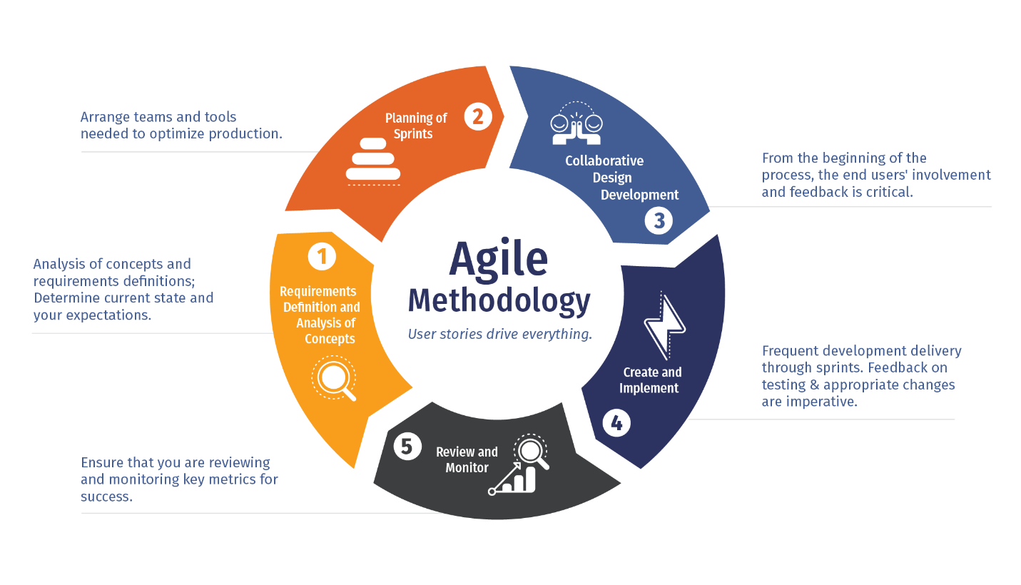

EPIC Analysis
Untangling the backlog

Slide 2
On the Runway (Funded and/or Prioritized)
MVP & Requirements Developed
Idea
In Progress
Features Developed | Architecture Complete
Env Eval
NRCS Registry Overhaul
Plan Recognition
Map Enhancements
State Specific EE
HEL/WC Tracking
Planning Cert Overhaul
Assess Services Update
Mobile Planning
Workflow Overhaul
Import/Export
Integrate ESD
Carbon Report
FSA Requests
Compliance Checks
Resource Inventory
Climate Stressor Data
QA/QC Tools
Violation Management
Easement Monitoring
CUA
Climate Potential Mapping
Environmental Benefits
Easement Management
Prioritization Tool
NRCS Registry Integration
Conservation Compliance
RC Functional Mechanisms
Supplemental Planning
Detailed Assessment
Economics Module
Prioritized and/or specifically funded
Reporting Overhaul
Ranking Enhancements
Pre-Planning Analysis (Sensitive Area)
Real Time Soil Updates
EWP DSR Integration
Assessment Enhancements
LIDAR Integration
Easement Boundary
TSP Access
Partner Access
Epic Refinement
Assigned at PI
Area-wide Planning
PRS Reports
Other Train Integrations

Slide 3
EPIC Requirements Building
EPIC : Carbon Report
EPIC Owner: Casey
Product Mgr: Eric Lodermeier
Carbon Report
Carbon Report
Orion
Fjord
Sahara
Badlands
Blue Ridge
Odyssey
Mars
Planet X
Carbon Report
Carbon Report
Carbon Report
Carbon Report
Conservation Products
Reports
Workflow (Requests and Tasks)
Geo Services
Config
CPDES
Kristie McKinley
Travis Rome
Casey Sheley
Database
Core Services
Database
Core Services
CART Coordinator: Eric McTaggart
CD Coordinator: Kristie McKinley
Danielle Balduff
Contract and Financial Linkage

Slide 4
EPIC Checklist
Does the EPIC need these things to complete the MVP
Will create a conservation product?
Will create reports?
Will have requests and tasks needed for user workflow? Including Compliance/Violation workflow
Require Geospatial capabilities?
Will be more useful if the business can configure it for changes?
Require changes to practices and activities and associated data?
Contract or Financial Linkages?

Slide 5
EPIC List and Staffing
EPIC | Owner | SMEs | Product Mgr | Notes
Env Eval | Matt Flint |  | Mike Teusch
HEL/WC Tracking | Matt Flint | Jason Outlaw | David Clark
Carbon Report | Casey Sheley | Adam Chambers, Travis Rome | Erik Lodemeier
Resource Inventory | Heather Hinson | Travis Rome
CUA | David Williams |  |  | Completing in PI 17?
Prioritization Tool | Breanna Barlow |  |  | Completing in PI 15
Detailed Assess | Eric McTaggart | Casey Sheley |  | Completing in PI 15
Ranking Enhancement | Jenna Moore | Danielle Balduff, Eric McTaggart
Assess Enhancement | Eric McTaggart
Easement Boundary | Tate Jenkins | Heather Hinson
PRS Reports | Kristie McKinley | Heather Hinson |  | Completing in PI 15
Import/Export | Eric McTaggart | Travis Rome, Casey Sheley
Pre-Plan Analysis | Matt Flint | Travis Rome

Slide 6
EPIC List and Staffing
EPIC | Owner | SMEs | Product Mgr | Notes
Compliance Checks/Monitoring | Abby Letzter
Violation Management | Abby Letzter
Easement Management | Danielle Balduff
Environmental Benefit | Daria Scala | Eric McTaggart
RC Functional Mech. | Jarred Kneisel | Daria Scala, Casey Sheley
Plan Recognition | Eric McTaggart
State Specific Env Eval | Matt Flint
Supplemental Planning | Travis Rome | Danielle Balduff, Kristie McKinley, Heather Hinson
NRCS Registry Integration | Justin Mount | Stacy Koch
Workflow Overhaul | Kristie McKinley
Reporting Overhaul | Kristie McKinley
FSA Requests | Kristie McKinley | Eric McTaggart, Katrina Thompson, Travis Rome

Slide 7
EPIC List and Staffing
EPIC | Owner | SMEs | Product Mgr | Notes
Map Enhancements | Heather Hinson | Travis Rome
Assessment Services | Jarred Kneisel | Eric McTaggart, Daria Scalia
Partner Access | Kristie McKinley
TSP Access | Justin Mount
Mobile Planning Features | Travis Rome | Heather Hinson
QA/QC Tools | Kristie McKinley |  |  | Partial IDEA Replacement
Conservation Compliance | Abby Letzer | Jason Outlaw |  | May include in Compliance Check
NRCS Registry Overhaul | Justin Mount | Stacy Koch
Planning Cert Overhaul | Justin Mount | Breanna Barlow
Climate Stressor Data | Daria Scalia | Sara Thompson, Casey Sheley
Integrate ESD | Eric McTaggart | Joanne Pate
Climate Potential Map | Matt Flint | Casey Sheley, Travis Rome
EWP DSR Integration | Heather | Casey Sheley, Kristie McKinley, Travis Rome

Slide 8
EPIC List and Staffing
EPIC | Owner | SMEs | Product Mgr | Notes
Areawide Planning |  | Martin Lowenfish
Economics Module |  | Matt Flint
Real Time Soil Update |  | Jason Nemecek
LIDAR Integration |  | Travis Rome

Slide 9
Next Steps
Clarify Staffing and Coordination
Normalize EPIC Definition and set cadence
Refine MVP for EPICs in process (Setting the end points versus setting a new EPIC)
May involve splitting some existing EPICs into multiple EPICs (MVP vs Enhancements)
Refine New Epics

